Slide 1
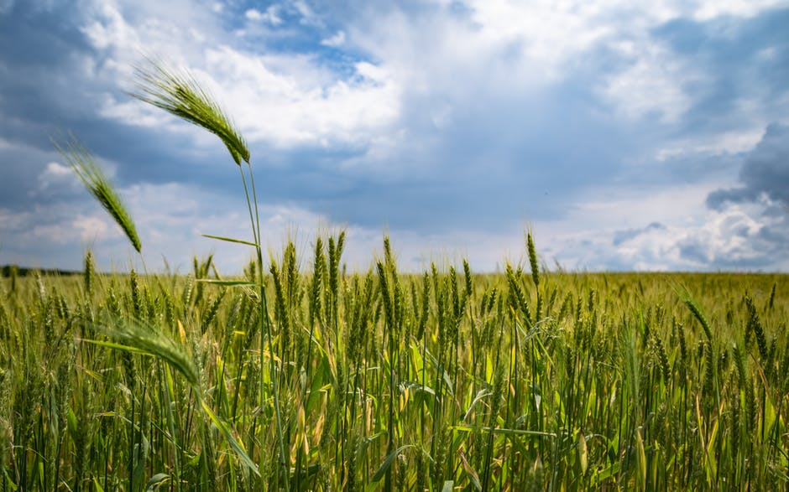


The next generation
AGRICOPTER
TCTD Challenge
IIT Madras

Slide 2
UNDERSTANDING THE FARMING PROCESS
TO MARKET
40-60% cost
HARVESTING
MAINTENANCE
PESTICIDES
FERTILISERS
SURVEYING
IRRIGATION
SOWING

Slide 3
“Identification of diseases in certain areas of the field is impossible for our labourers. We have no option but to spray the entire field with pesticides every single time. Farmers in Punjab will be very happy to welcome new technologies in our farms and believe they can work miracles for us.”
–Sandeep Verma,
Farmer, Punjab
FROM OUR STAKEHOLDERS
“No way for us to check plant health and take necessary action. We spray more than required as a result of manual inefficiencies.”
–Aniyan Thomas
Farmer, Kerala
“Regions around Chennai are currently facing a situation where the agriculture labour force is starting to decrease. There is a severe lack of cheap labour, and the cost of spraying is going north of Rs. 400 per acre. Lack of labour also implies delays in spraying, which has resulted in large crop losses over the past few years. Spraying of fertilizers through drones can prove to be highly promising.”
– Mr. Karthik,
MCRC, Chennai
“Spraying is very time consuming. It takes us 6 hours to spray my 2 acre land. It is also very difficult for me to check plant health and take necessary action.”
–Bharat Patil,
Farmer, Alwar, Rajasthan
“Over-spraying of pesticides is a pressing real world issue. New and innovative technology offers a promising way to tackle this problem.”
– Prof. Sandhya Seetharaman,
RuTAG, IIT Madras
“Regular surveying is an absolute necessity in a situation where over 30% of crops are lost every year. “
–Siddharth Dialani,
Founder, LeanAgri Solutions, Pune

Slide 4
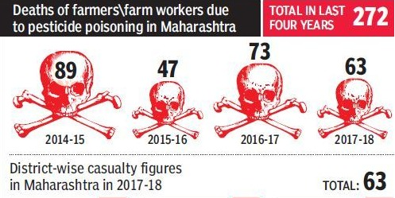
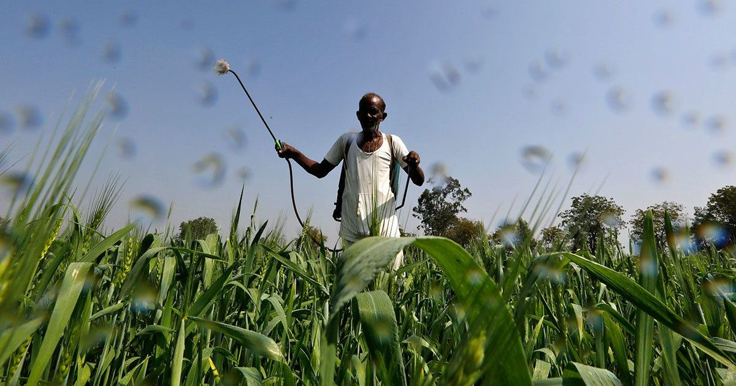
WHAT WE ARE TRYING TO SOLVE
Health Hazard : 10,000 farmers hospitalized every year due to pesticide poisoning (The Hindu)
Over-spraying : 1.4 times the actual required amount of pesticides are sprayed yearly. (Silsoe research institute)
Lack of awareness : 99.5% farmers uneducated about optimum dosage and safety measures (NCIPM – National Centre for Integrated Pest Management)
Mismanagement : 37% of rice crop lost to pests and diseases every year (IRRI-International Rice Research Institute)
*Source: Times of India
Spraying without protective gear

Slide 5
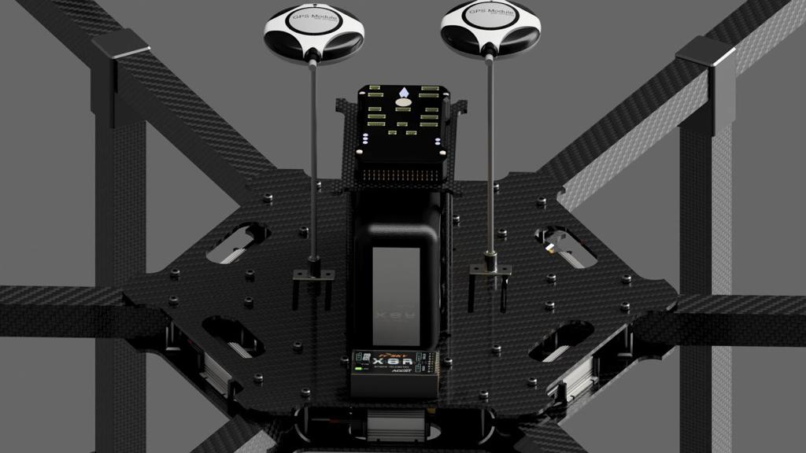
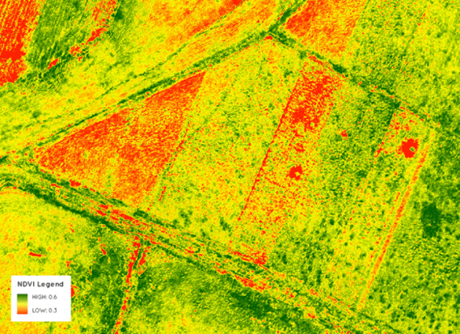
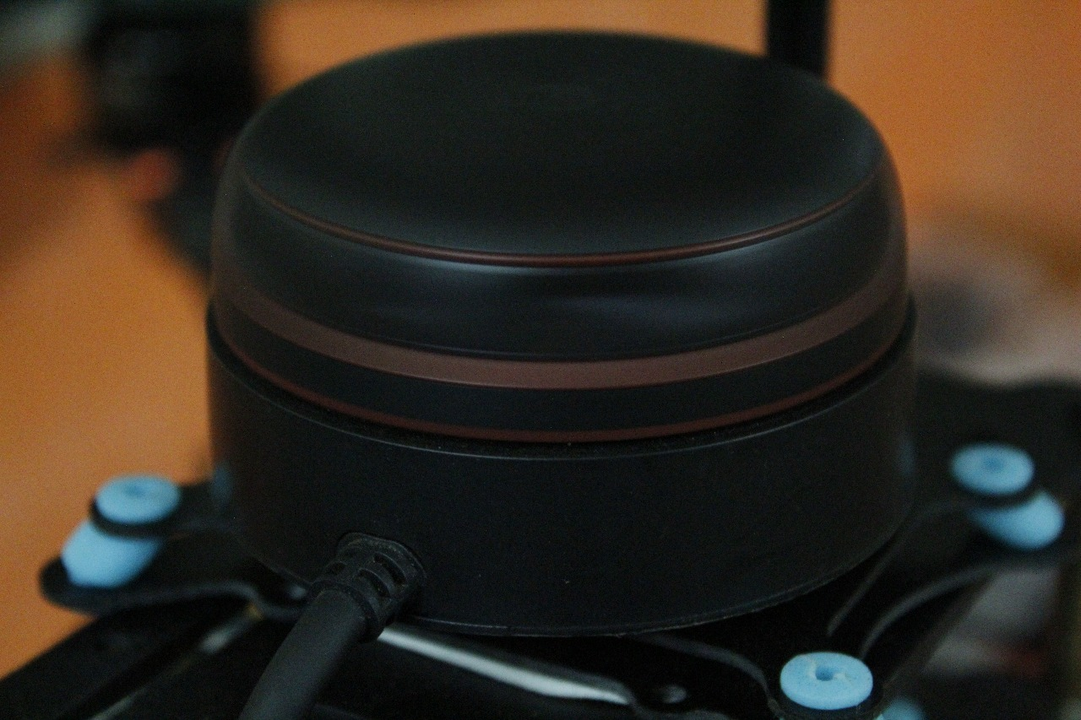
OUR SOLUTION
SURVEYING
Multispectral Imaging: Map stressed areas and identify diseased crops.
Path Planning: Plans the optimum flight
path. Features obstacle avoidance
Farm Monitoring Application: Track and monitor farm progress
over the season
SPRAYING
SPRAYING
Automated Spraying: The farmers never come in contact with the pesticides!
Patch Spraying: 40% savings in pesticides through patch spraying.
8x Faster:
Manual Labour 0.25acres/hr
AgriCopter 2acres/hr
Automatic Refilling: Refills the tank in 3 mins.

Slide 6
CURRENT ACHIEVEMENTS
Obstacle avoidance
Autonomous flight
Comprehensive Safety: Complies with DGCA regulations
Terrain follow
Precision landing
Multiple sensors: Better state estimation and redundancy
Optimised power system: Enhanced flight time
Spray monitoring software application
Extended Kalman Filter: Fused State estimation-22 states
Selection of spray nozzle system
THE DRONE
novel design
SENSOR | PURPOSE
3x Compass | Heading and Yaw
2x IMU | Acceleration, Gyroscope
2x GPS | Position Feedback
1x 1D LIDAR | Relative Altitude
1x 2D LIDAR | Obstacle Avoidance
1x Barometer | Absolute Altitude
2x STM32F427 | Fallback and Redundancy
1x PX4 Flow | Accurate Velocity
UPCOMING IMPLEMENTATIONS
Refilling and spray system testing
Trajectory Optimisation: UB-ANC Algorithm
Nvidia Jetson TX2
Motor Failure Redundancy
Multispectral Imaging

Slide 7
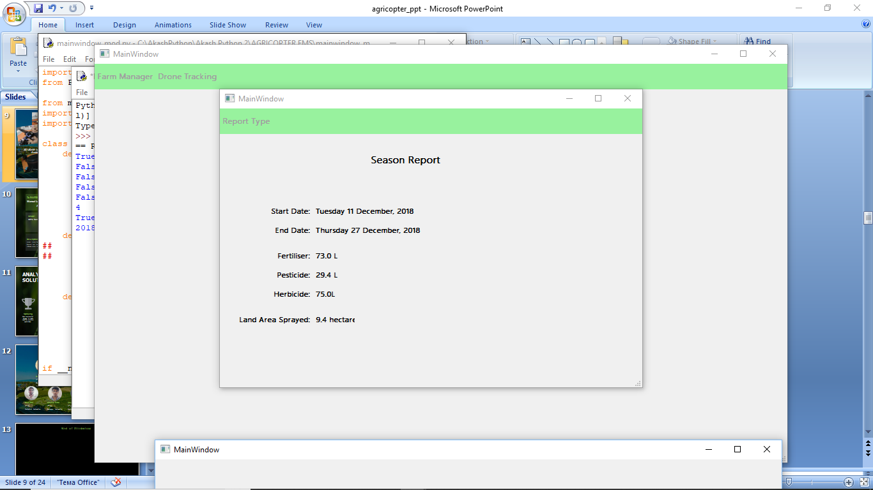
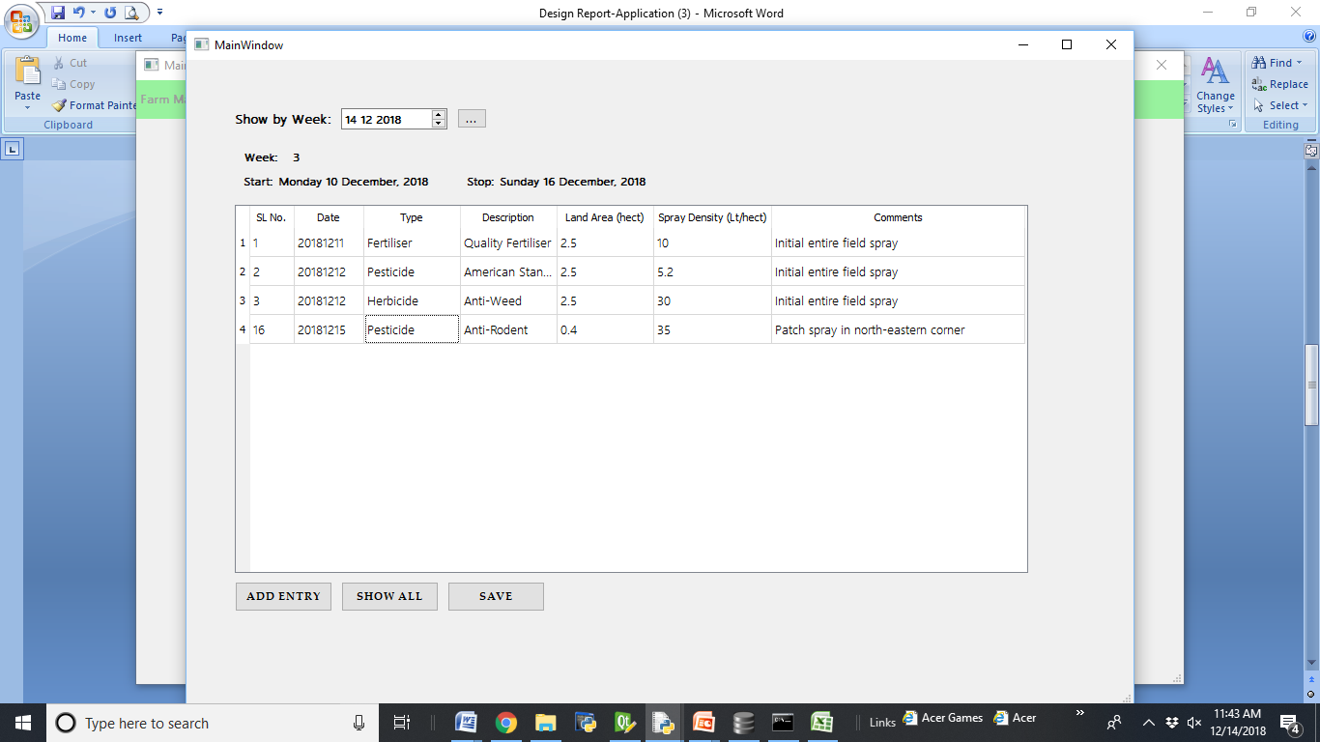
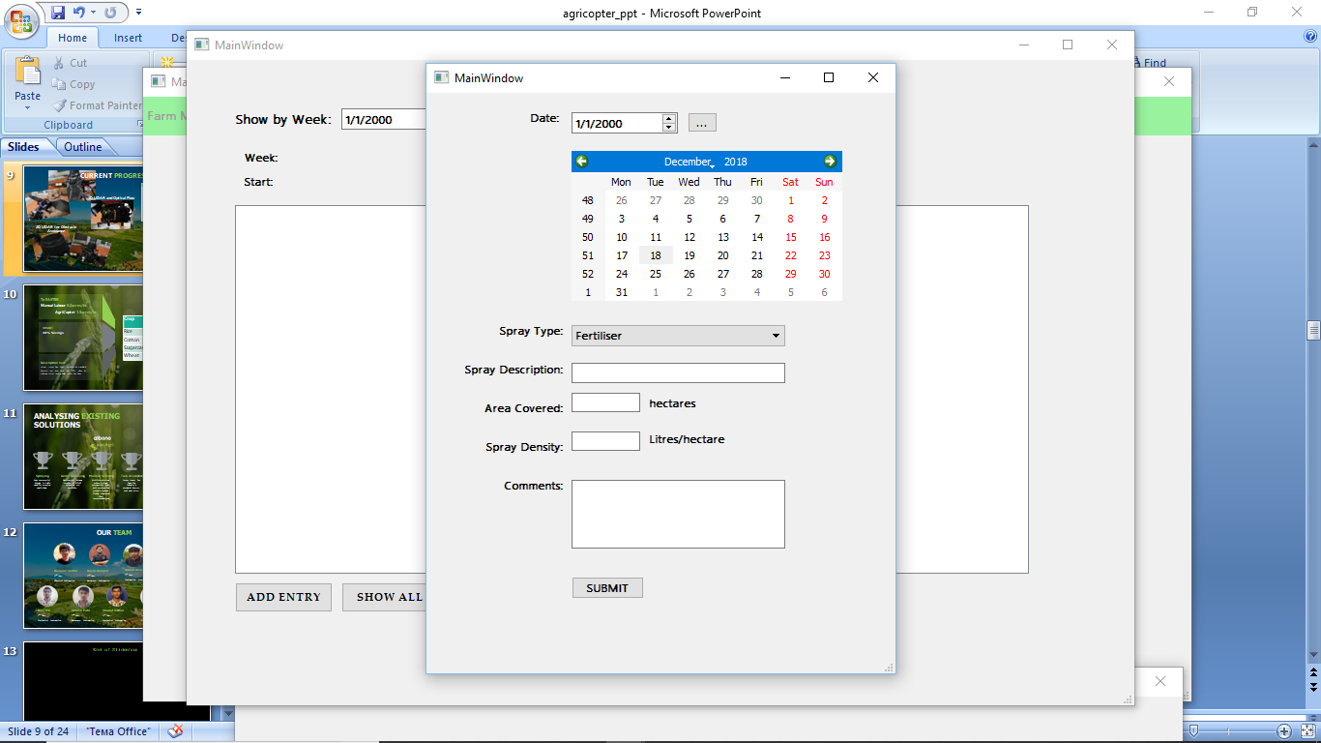
Built in-house
Main Features:
Spray Analysis
Survey Analysis
Drone Stats
FARM MONITORING
SOFTWARE APPLICATION
SURVEY
TRACKING
DRONE STATS

Slide 8
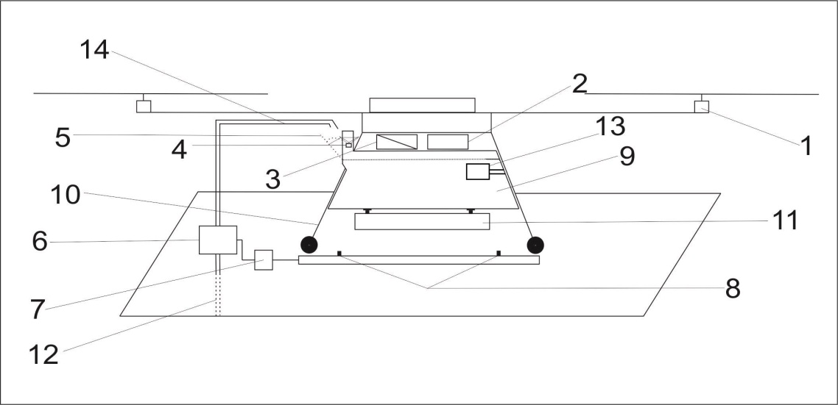
AUTOMATIC SPRAY
REFILLING SYSTEM
Portable
Compatible with any tank
Cost effective
Fully autonomous
Patent IDF no:1812
Requirement | Every 2.5mins
Fast | Refill within 3 mins
Effective | 1 base tank covers 5 acres

Slide 9
SERVICE BASED OPERATIONS MODEL
OUR PARAMETER CALCULATIONS:
nozzle discharge rate = 0.1 L/s
volume sprayed = 70L/acre
total spray time = 70(L/acre) / 0.1(L/s) = 700 s
= 11.6min
horizontal distance covered = 960m/acre
horizontal drone speed = 960 / 700 = 1.4m/s
drone height = 3.5m
effective spray width = 4.5m
tank capacity = 15L
refilling rate= 7.5L/min
refilling time = 15 L / 7.5 L/min = 2 min
precision landing time = 1 min
overall net time = 11.6 + (2 + 1)*5 = 26~ 30min/acre
FACTOR | HUMAN | AGRICOPTER
TIME | 4 hours/acre | 30 mins/acre
SPRAYING | 40% over-spray | <5% over-spray
HEALTH | Direct Exposure | No Exposure
SPRAY RATE | 0.6 Litre/min | 6Litre/min
COST | ₹ 350/acre | ₹ 350/acre

Slide 10
BUSINESS MODEL ANALYSIS
REVENUE MODEL
ASSUMPTION: area of each farm = 3 Acres
SPRAYING
time per farm = 90 mins
daily operating time = 7.5 hours
farms per day= 5 farms
cumulative area covered = 5 * 3 = 15 acres/day
spray price = ₹350/acre
Revenue per day = 350 * 15 = ₹5,250 per done
Total drones per operator = 3
Total Revenue = 5250 * 3 = ₹ 15,750 per day
SURVEYING
Surveying = ₹ 100/acre
FIXED COST
COMPONENT | COST (₹)
Motors | 41,000
ESCs | 26,000
Propellers | 19,000
Frame | 37,500
Batteries | 60,000
FCU and Sensors | 45,000
Spray System | 20,000
Multispectral | 2,00,000
Total | ₹ 4.30L/drone
VARIABLE COST
FACTOR | COST (₹)
LOGISTICS | 400/day
ON-SITE OPERATOR | 600/day
Total | 1000/day

Slide 11
SAVE TIME, MONEY AND LIVES

Slide 12
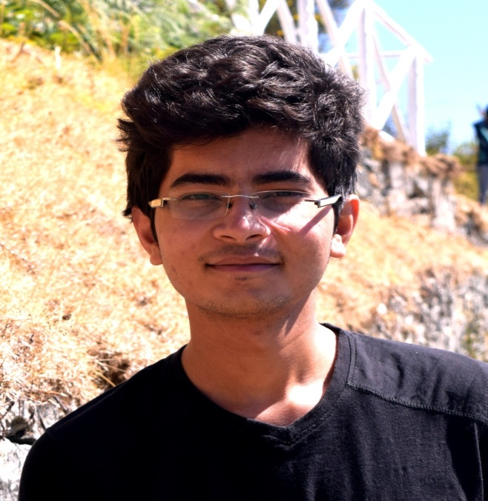
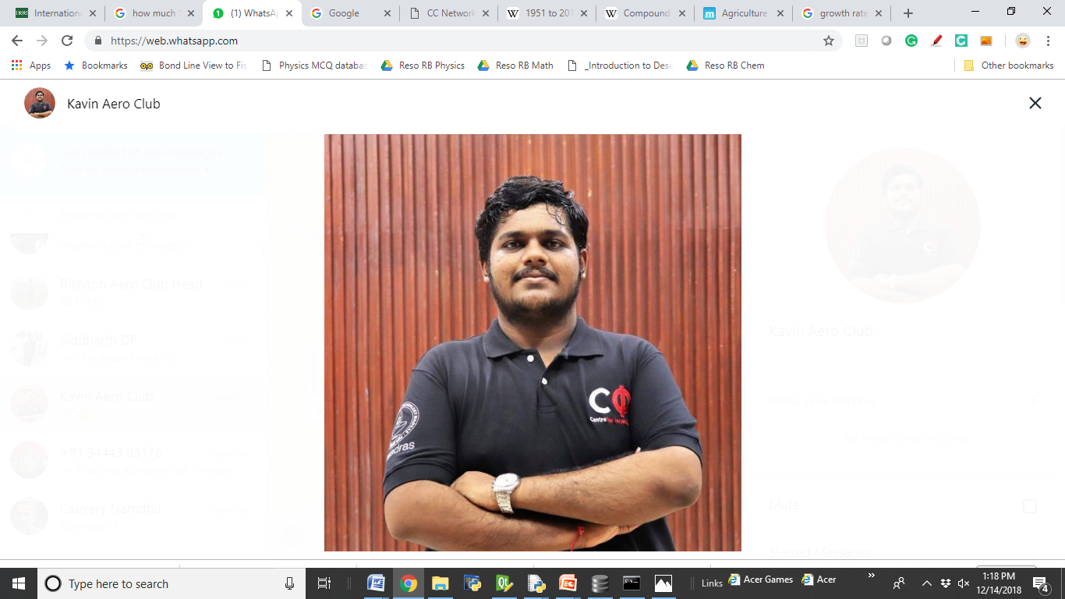
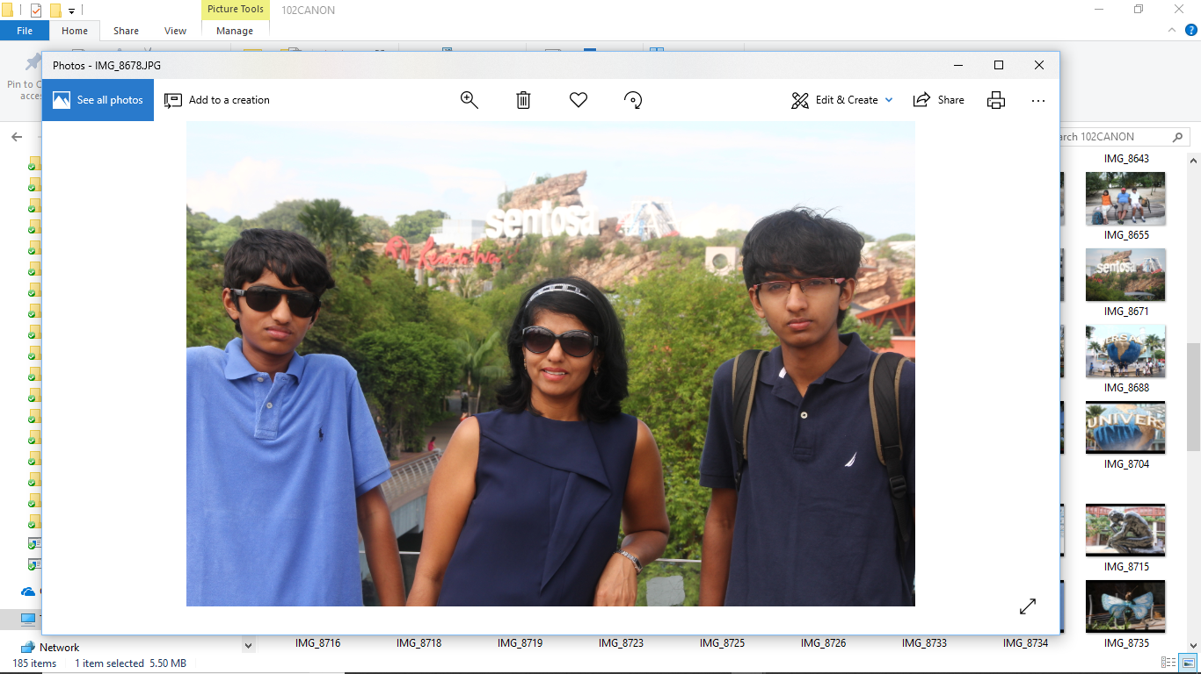
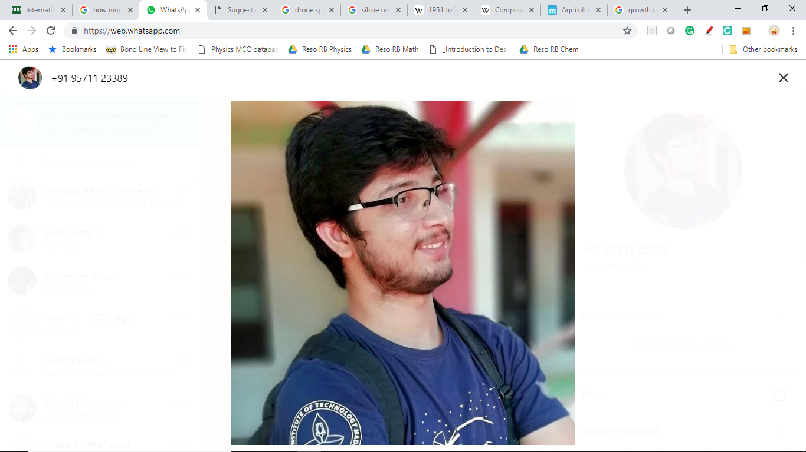
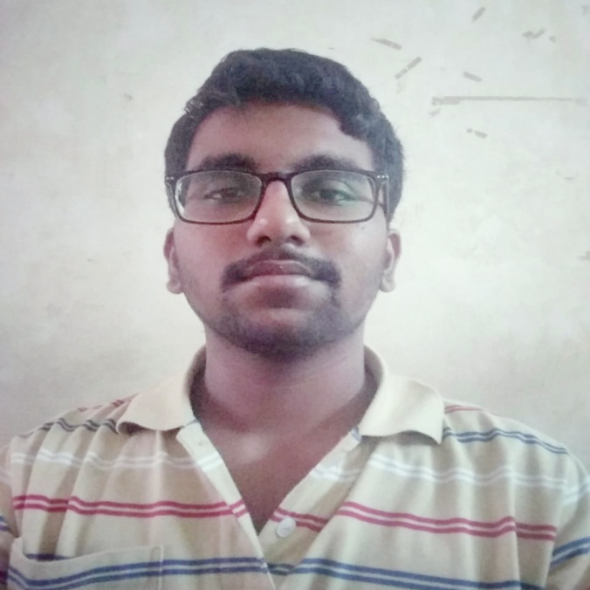
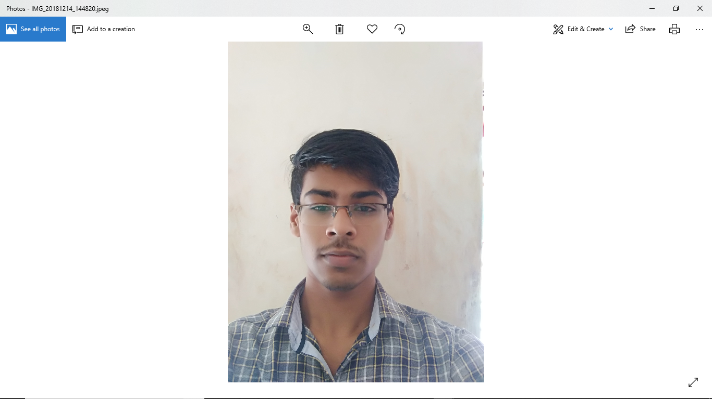
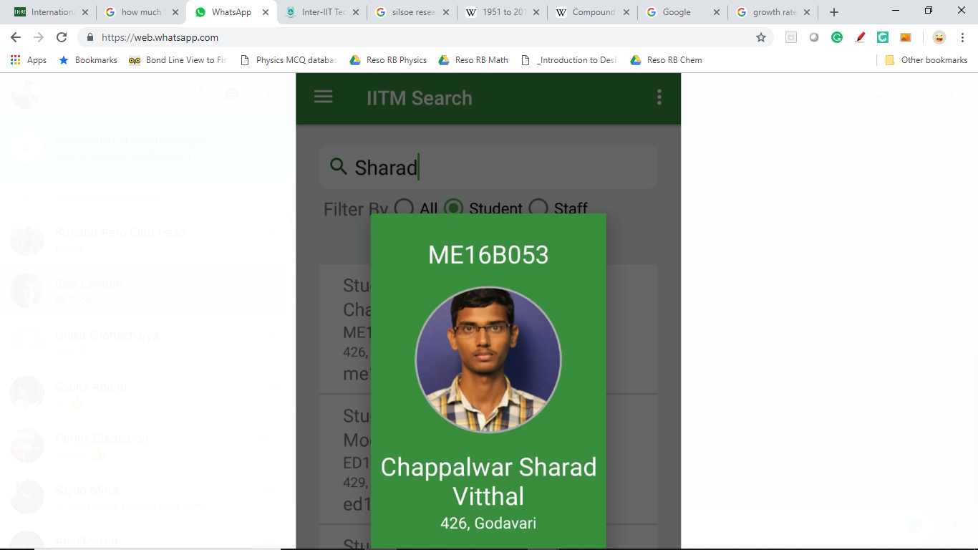
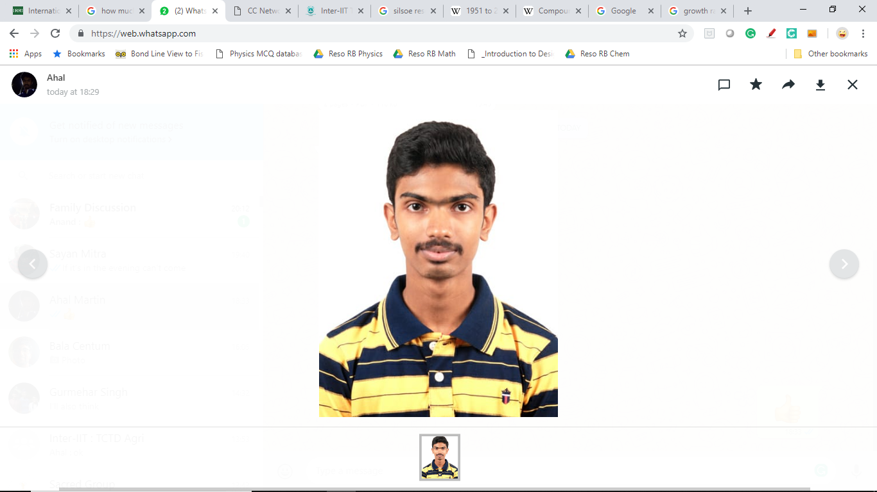
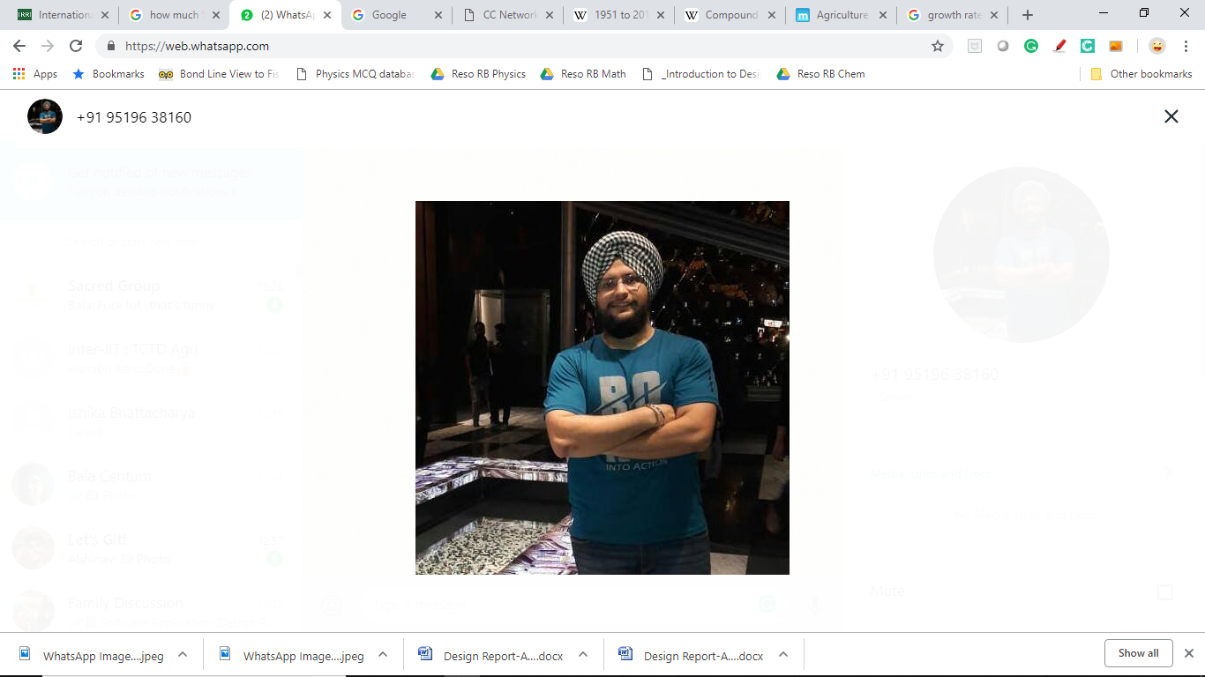
OUR TEAM
Rishabh Verma
3rd Year,
Chemical Engineering
Kavin Kailash
3rd Year,
Aerospace Engineering
Akash Anand
1st Year,
Engineering Design
Arnav Mishra
2nd Year,
Aerospace Engineering
Bala MC
1st Year,
Mechanical Engineering
Adarsh Patil
2nd Year,
Aerospace Engineering
Sharad Vitthal
3rd Year,
Mechanical Engineering
Ahal Martin V
1st Year,
Mechanical Engineering
Samarjeet Singh
MS,
Aerospace

Slide 13
End of Slideshow

